Slide 1
Controlling System
Flow chart:

Slide 2
START
DISPLAY INSERT THE COIN ON LCD
COIN ACCEPTED
Dispense glass
Deciding type of water
START THE TAP FOR 10 sec
WATER DISPENSED
STOP

Slide 3
Electronic Components
Hardware:
Arduino Mega
Servo motors (10kgcm)
Relay for operating heater
WIFI Module for communication.

Slide 4
Need for water level measurement
The water level present In the smaller and larger container should be known so that flow rate of the water can be determined.
This change in the flow rate will change the time required to fill the glass.

Slide 5
Methods for measuring water level:
Counting amount of water dispensed.
Weight measurement.
Level Measurement.

Slide 6
Counting amount of water dispensed.
This is based on the assumption that initial volume of the water in both the containers is known.
By knowing the water dispensed , The actual volume and head available can be found and hence the flow rate can be estimated.
This method is completely theoretical, doesn’t need any instrumentation but depends mainly upon initial volume calculation accuracy.

Slide 7
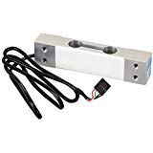
Weight measurement.
This method includes measuring the weight of water present in the container by using load sensor and then from weight measuring the head, flow rate and then estimating time for filling the glass.
This method requires an load cell for weight measurement but it is more accurate with easy to interpret results.

Slide 8
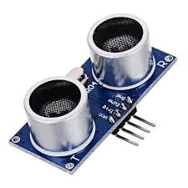
Water level measurement
Water level or head of water available can be easily found using an ultrasonic sensor.
The ultrasonic sensor can be placed above the larger plastic container so that thickness of container comes in blind range of the sensor and it can give water level present in the container.
But these results are subjected to error due to presence of the plastic wall in blind range of sensor.

Slide 9
Internet of things :
The IOT is used for making the water dispenser smart.
This is done by establishing the communication between water dispenser and another device connected to internet like a smartphone.
By establishing the communication, these two devices can exchange information like water level, No of normal and hot water glasses dispensed in a day.

Slide 10
IOT Block Diagram
Internet
Dispenser Controller
Smart
Phone
WiFi
ESP
8266

